Slide 1
Modern search
With Lucene.Net

Slide 2

Modern search
With Lucene.Net

Slide 3
Modern search
With Lucene.Net
Also with Joel Kauffman
Notes:
Introduction

Slide 4
What is lucene.NET?
Notes:
What is Lucene?
Offshoot of Java project
Open Source (apache 2)
Used by Stack Overflow
Software library – not a complete app

Slide 5
What if I want a complete app?
Notes:
Solr
ElasticSearch (github, Netflix, facebook)
ElasticSearch is offered as a managed service by Amazon

Slide 6
LUCENE.NET VS MS-SQL Full Text Search

Slide 7
 | LUCENE.NET | MS-SQL FTS
Auto Updating Index | No | Yes
Store Data in Index | Yes | No
Location in RAM | Yes | No
Interface | API | SQL
Querying Multiple Columns | Yes | Yes
Stop words, synonyms, sounds like | Yes | Yes
Custom Index Structure | Yes | No
Wildcards | Yes | With Restrictions
Spellchecking, hit highlighting, etc. | In “contrib” extensions | No
Notes:
So, MS FTS will handle updating the index.

Slide 8
 |  | MS-SQL FTS | Lucene (File System) | Lucene (RAM)
Cold System | Simple Query | 56 | 643 | 21
 | Boost Query | 19669+ | 859 | 27
Second Query | Simple Query | 14 | 8 | <5
 | Boost Query | 465 | 17 | 9
Query times in Milliseconds
Notes:
SQL Server is a little faster with simple queries executed first time, and is way behind in case of complex query with custom scoring criteria. And Lucene with index placed in RAM is unbeatable favorite.

Slide 9
How do I get it?

Slide 10
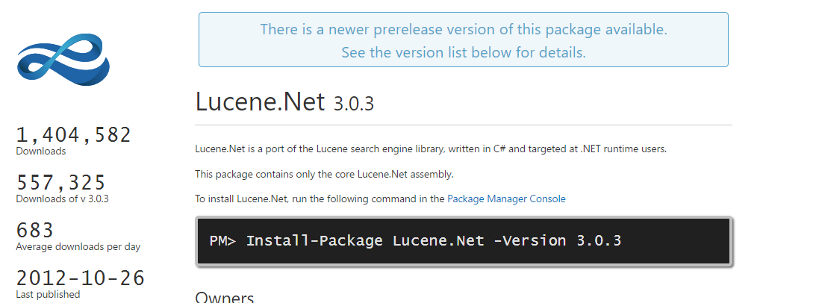
Notes:
Easiest Lucene.Net 3.0.3

Slide 11
Notes:
Brave way: 4.8.0.770-beta
Considered more stable than 3.0.3 because it’s unit tested and .NET-ified

Slide 12
Why are there two versions in different places?
Notes:
Politics of Java Libraries

Slide 13
http://code972.com

Slide 14
https://github.com/apache/lucenenet
Notes:
Latest bits

Slide 15
https://cwiki.apache.org/confluence/display/LUCENENET/Lucene.Net
Notes:
This is hard to read, but that’s ok because, like all documentation, it’s also woefully out of date

Slide 16
How do I Get Started?

Slide 17
DIRECTORY
Notes:
Directory or RAM

Slide 18
Notes:
Directory place where Lucene stores its files.
Directory should only be opened once.

Slide 19
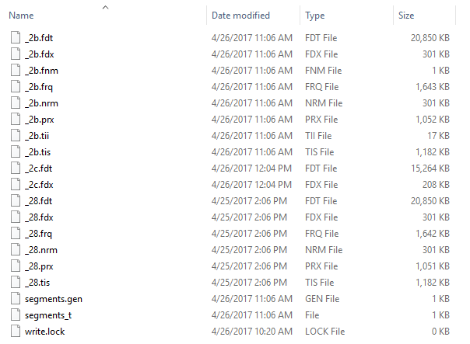

Slide 20
ANALYZER
Notes:
Tokens, Stop words, filters

Slide 21

Notes:
Keyword - treats the entire stream as a single value (useful for zip codes, ids)
Simple - filters letters, uses a lower case filter
Stop - Removes Stop Words (in English), can use a pre specified set of stop words
Whitespace – tokens on whitespace
Standard – analyzer with default stop words

Slide 22

Notes:
PerField (default analyzer)
Customize the analyzer on fields (which we’ll get to)

Slide 23
indexwriter

Slide 24
Notes:
You can only have one writer open at a time.

Slide 25
documents

Slide 27
FIELDS
Notes:
Fields have 4 things
Name
Value
Storage
Indexing

Slide 28
Field.store.yes Field.store.no
Notes:
Just because a field is not stored, does not mean it cannot be indexed, it just means it cannot be retrieved

Slide 29
Field.index.analyzed field.index.not_analyzed field.index.no
Notes:
Analyzed = tokenized
Not analyzed = store as single value
No = don’t index (but probably stored)

Slide 31
Indexreader

Slide 32
Notes:
This is a read-only snapshot of the data

Slide 33

Notes:
This is the same as calling commit() and then opening a new reader and provides a near-real-time read-only reader

Slide 34
indexsearcher

Slide 35
Notes:
Creating a searcher is expensive

Slide 36
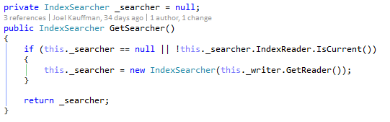

Slide 37
queries

Slide 38
fields

Slide 39
title:“ASP.NET for fun” AND text:go

Slide 40
title:Do it right
Notes:
This will only search for “Do” in the title field

Slide 41
wildcards

Slide 42
te?t test* te*t
Notes:
First one finds test, text
Second finds test, tester, testing
Last finds test, text, tesseract
Wildcards cannot be at the beginning of a word

Slide 43
Fuzzy searches

Slide 44
roam~
Notes:
Finds foam, roams

Slide 45
roam~0.8
Notes:
Number is 0-1 determines similarity
Default is 0.5

Slide 46
proximity

Slide 47
“panel bad”~10
Notes:
Finds panel and bad within 10 words of each other

Slide 48
range

Slide 49
mod_date:[20170101 TO 20170501]

Slide 50
title:{angular TO jquery}
Notes:
Non-inclusive

Slide 51
boosting

Slide 52
lucene search

Slide 53
lucene^5 search

Slide 54
lucene search^0.2
Notes:
Must be positive, default is 1

Slide 55
Boolean operators

Slide 56
And &&

Slide 57
OR ||

Slide 58
NOT !
Notes:
Can’t use not with just one term (will return zero results)

Slide 59
lucene -sql

Slide 60
+lucene search
Notes:
Must include the term

Slide 61
grouping

Slide 62
(lucene OR sql) AND search

Slide 63
Queryparser

Slide 65
Notes:
Parser.defaultoperator
Parser.allowleadingwildcard (slow)

Slide 66
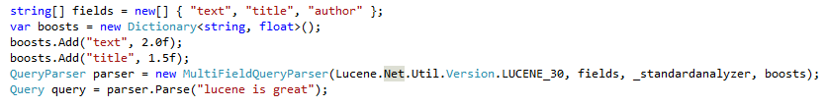

Slide 67
Searching
Notes:
Finally!

Slide 68

Notes:
1000 is suggested for max hits because afterwards it dramatically slows down

Slide 69
Notes:
Scoredocs is an array of type of scoredoc which has a document id and a score

Slide 70
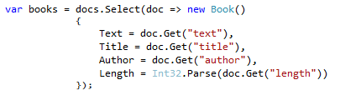
Notes:
There are libraries out there to handle mapping
Check out lucene.net.linq

Slide 71
Managing the index

Slide 72
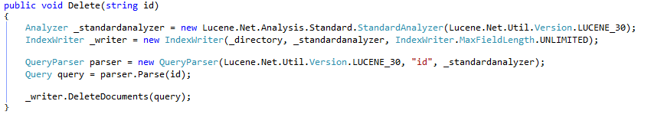

Slide 73
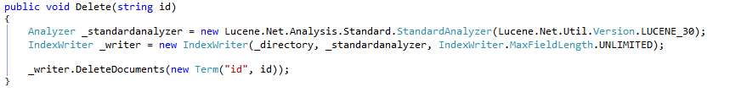

Slide 74


Slide 75
Lucene.net.contrib
Notes:
Analyzers for non-English
Hit highlighting
Regex queries
“morelikethis” query
Spellchecker
Also check out lucene.steroids (replication)

Slide 76
Joel Kauffman @ifranto kauffmanjk@gmail.com
Github.com/ifranto/modernsearch

